Slide 1

Numerical Methods for Pricing Options with Transaction Costs
Federico Gaspar Vega

Slide 2
Introduction
The price of the underlying derivative follows a Geometric Brownian Motion.
The drift, the volatility and the riskless interest rate are constant.
No dividends are paid in that time period.
The market is frictionless, thus there are no transaction costs (fees or taxes).
The interest rates for borrowing and lending money are equal.
All parties have immediate access to any information.
All securities and credits are available at any time and any size.
There are no arbitrage opportunities.
"Up until the time when Black and Scholes came up with their insight, the options world was full of uncertainty and risk. Then, in a moment of tremendous clarity, Black and Scholes realised that two risky positions taken together could effectively eliminate risk itself. In that moment of brilliance they created the most important equation in the modern day finance"
Stan Jonas.

Slide 3
Introduction
The price of the underlying derivative follows a Geometric Brownian Motion.
The drift, the volatility and the riskless interest rate are constant.
No dividends are paid in that time period.
The market is frictionless, thus there are no transaction costs (fees or taxes).
The interest rates for borrowing and lending money are equal.
All parties have immediate access to any information.
All securities and credits are available at any time and any size.
There are no arbitrage opportunities.
"Up until the time when Black and Scholes came up with their insight, the options world was full of uncertainty and risk. Then, in a moment of tremendous clarity, Black and Scholes realised that two risky positions taken together could effectively eliminate risk itself. In that moment of brilliance they created the most important equation in the modern day finance"
Stan Jonas.

Slide 4


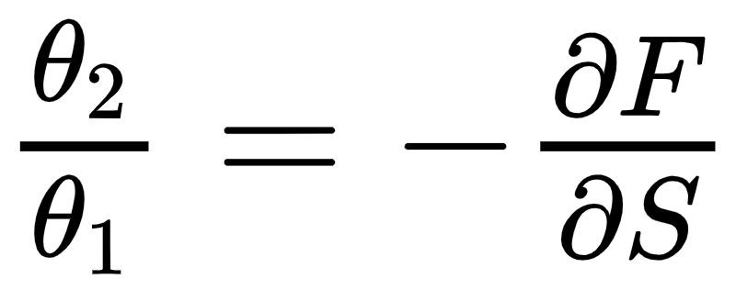
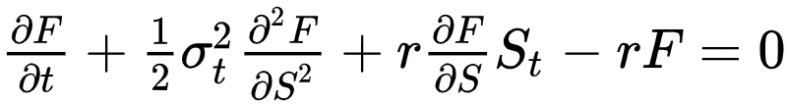
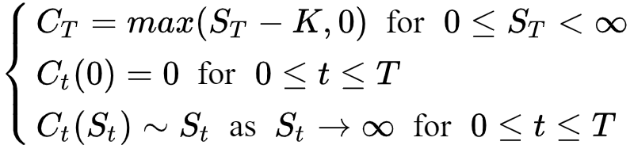
Black Scholes
Model
The price of the underlying derivative follows a continuos Geometric Brownian motion:
A portfolio with:
Continuos hedging is achieved if and only if:
This ideas yields to the very well known BS equation:
The initial and boundary condition to this pde are:

Slide 5
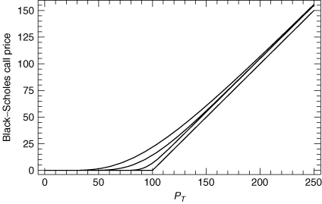
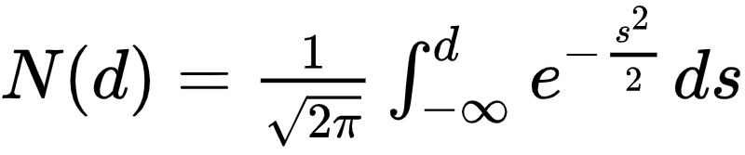
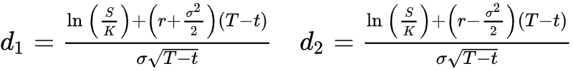
Black Scholes
Solution
The solution to this pde can be written as:
where N is the cmf of the normal distribution:
and d₁ and d₂ are constants:

Slide 6
Transaction costs
The Black–Scholes model requires a continuous portfolio adjustment in order to hedge the position without any risk. If the cost associated with the rehedging are independent of the time scale then the infinite number of transactions needed to maintain a hedged position until expiration leads to infinite total transaction costs. Thus, the hedger needs to find the balance between the transaction costs that are required to rebalance the portfolio and the implied costs of hedging errors. As a result to this “imperfect” hedging, the option might be over or under priced.
Leland
Amster

Slide 7
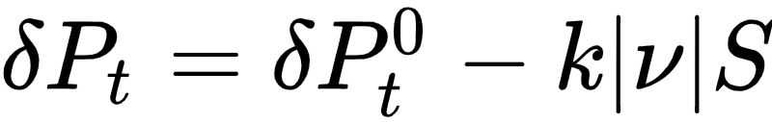

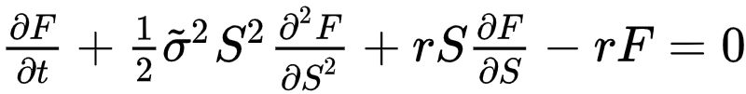

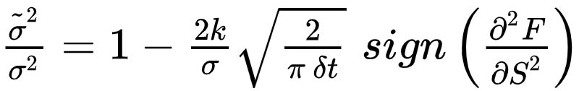
Leland Model
The portfolio is revised every finite fixed time step δt.
The underlying follows a discrete geometric brownian motion.
The transaction cost is proportional to the monetary value of the transaction.
A hedged portfolio has a return equal to a risk free zero coupon bond.
After a time step the value of the hedged portfolio is:
where k is the round trip transaction cost per unit dollar and |𝜈| is the number of assets traded. If the portfolio is hedged with the same strategy as in BS then:
where,

Slide 8

Amster Model
The modified Black Scholes equation when ones consider this transaction cost term is:
This is a manifestly non-linear differential equation which is really hard to tackle analytically.
Amster model is a generalization of the Leland model. They consider a portfolio where the transaction costs behave like a non-increasing linear function:

Slide 9
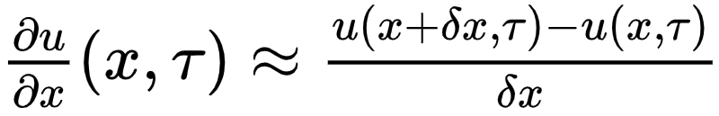
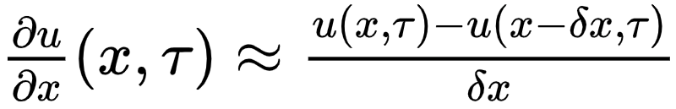
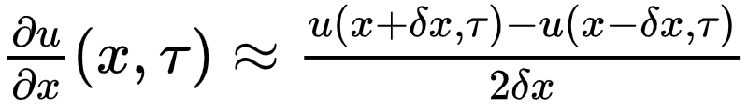
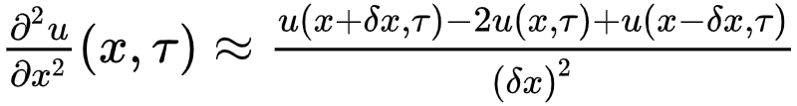
First Derivative
Numerical Methods
Second Derivative
Forward difference:
x₀
t₀
t₁
t₂
t_{N-1}
t_{N} = T
Backward difference:
x₁
x₂
Central difference:
x_{M-1}
L = x_{M}
Central difference
Unknown solution
Boundary conditions

Slide 10







Leland Model
Explicit Method vs Implicit Method

Slide 11
Leland Model
Explicit Method vs Implicit Method
LU - Decomposition

Slide 12




Amster Model
Explicit Method vs Implicit Method

Slide 13
Numerical Accuracy
The fundamental necessary and sufficient stability condition for a system like y_{t}= b+Ay_{t-1} is 𝜇(A)<1, where 𝜇(A) is the spectral radius of A.
Matrix norms has the property 𝜇(A)<f(A) and hence, a sufficient stability condition is f(A)<1, where f(A) is any matrix norm function.
In our case we have selected:
Stability
Convergence

Slide 14
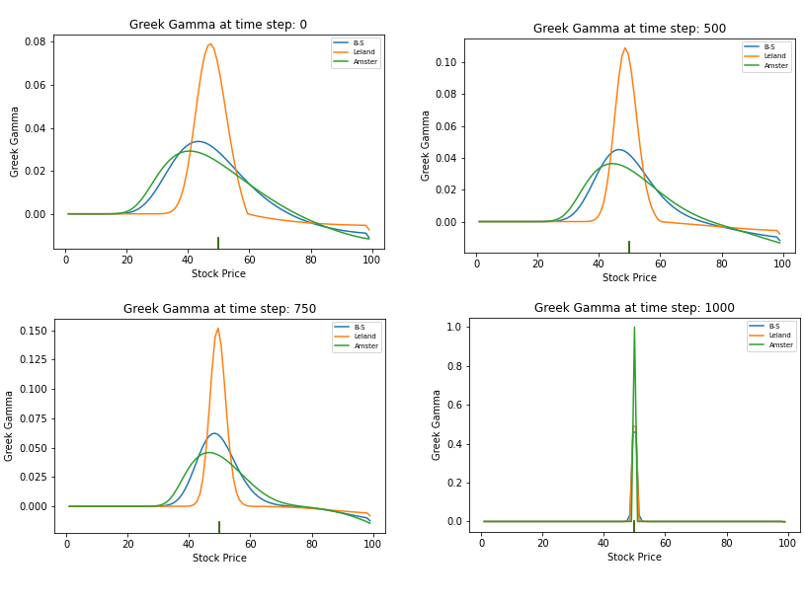
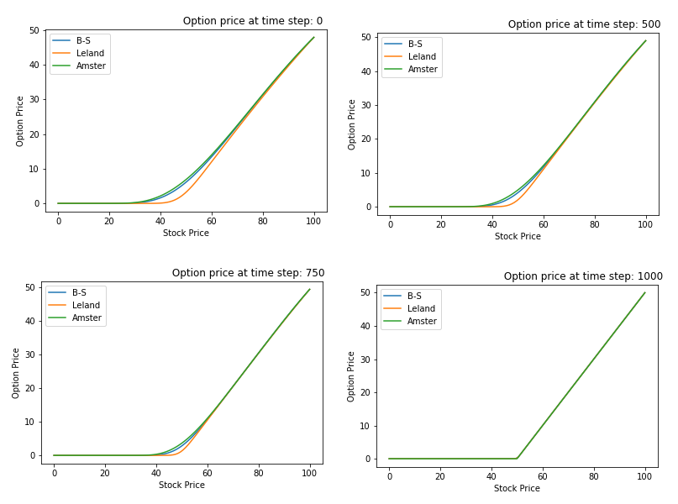
Summary and Conclusions

Slide 15
Further Work
Study the spectral radius for thighter bounds of stability
Studying the consistency of the implemented methods
Implement Crank Nicholson method
Optimal δt that maximizes the value of the portfolio
Compare this model with real data
Other models (Avellaneda, Banner & Sooner, … )

Slide 16





Amster Model Revisited
Perturbative Models -
B-S Operator and Fundamental Solution:
Perturbative Model and Solution:
known solution!
Boundary Conditions:

Slide 17


Slide 18
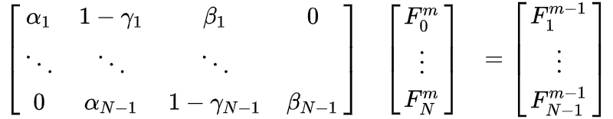
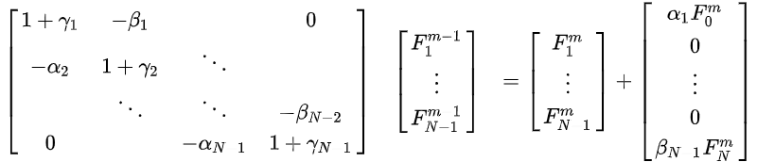
Additional Back Up
Explicit Method
Implicit Method

